Slide 1
HNDIT 2312-Principles of Software Engineering
Week 11: Software Configuration Management

Slide 2
Topics Covered
Change management
Version management
System building
Release management

Slide 3
Configuration management
Configuration management (CM) is concerned with the policies, processes and tools for managing changing software systems.
Because software changes frequently, systems, can be thought of as a set of versions, each of which has to be maintained and managed.

Slide 4
CM activities
Change management
Version management
System building
Release management

Slide 5
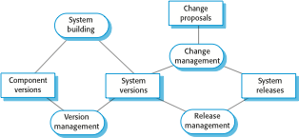
Configuration management activities

Slide 6
Change management
Keeping track of requests for changes to the software from customers and developers, working out the costs and impact of changes, and deciding the changes should be implemented.

Slide 7
Change request form
Change Request Form
Project: SICSA/AppProcessing Number: 23/02
Change requester: I. Sommerville Date: 20/01/09
Requested change: The status of applicants (rejected, accepted, etc.) should be shown visually in the displayed list of applicants.
Change analyzer: R. Looek Analysis date: 25/01/09
Components affected: ApplicantListDisplay, StatusUpdater
Associated components: StudentDatabase

Slide 8
Version management
Keeping track of the multiple versions of system components and ensuring that changes made to components by different developers do not interfere with each other

Slide 9
Codelines and baselines
A codeline is a sequence of versions of source code with later versions in the sequence derived from earlier versions.
A baseline is a definition of a specific system.
The baseline therefore specifies the component versions that are included in the system plus a specification of the libraries used, configuration files, etc.

Slide 10
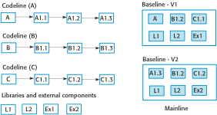
Codelines,baselines and mainlines

Slide 11
Version management systems
Version and release identification
Storage management
Change history recording
Independent development
Project support

Slide 12
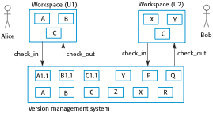
Version management systems

Slide 13
Branching and merging
Branching
A branch allows you to create a copy (or snapshot) of the repository that you can modify in parallel without altering the main set.
Merging
Once you’re comfortable with the experimental code, you will want to make it part of the trunk or master again.

Slide 14
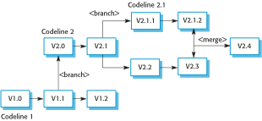
Branching and merging

Slide 15
System building
The process of assembling program components, data and libraries, then compiling these to create an executable system.
System building tools and version management tools must communicate as the build process involves checking out component versions from the repository managed by the version management system.

Slide 16
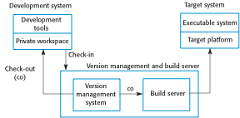
Development, build, and target platforms

Slide 17
Release management
Preparing software for external release and keeping track of the system versions that have been released for customer use.
Major releases which deliver significant new functionality.
Minor releases, which repair bugs and fix customer problems that have been reported.

Slide 18
Release planning
As well as the technical work involved in creating a release distribution, advertising and publicity material have to be prepared and marketing strategies put in place to convince customers to buy the new release of the system.

Slide 19
Factors influencing system release planning
Technical quality of the system
Platform changes
Lehman’s fifth law
Competition
Marketing requirements
Customer change proposals

Slide 20
Software configuration management tools
VSS – Visual source safe
CVS- Concurrent version system
Rational Clear Case
SVN- Subversion
Github
TortoiseSVN
IBM Rational team concert
IBM Configuration management version management

Slide 21
Key points
Configuration management is the management of an evolving software system.
The main configuration management processes are change management, version management, system building and release management.
Version management involves keeping track of the different versions of software components as changes are made to them.

